Slide 1
E-Governance
Chapter - 2 : Models of E - Governance
Notes:
Are your classroom colors different than what you see in this template? That’s OK! Click on Design -> Variants (the down arrow) -> Pick the color scheme that works for you!
Feel free to change any “You will…” and “I will…” statements to ensure they align with your classroom procedures and rules!

Slide 2
E-Governance Models
E-governance is defined as applications of ICT to government activity.
However, this can be manifested in different ways and models.
Models for e-governance, especially in the developing countries, are essential for a right perspective on e-governance implementation.

Slide 3
Models of Digital Governance
Models of digital governance are still evolving in developing countries.
A few generic models have been shaped up, which are finding greater recognition and are being replicated.
These models are based on the inherent characteristics of ICT such as enabling equal access to information to anyone who is a part of the digital network.
In simpler terms, information does not reside at any one particular node in the Digital Governance Models but flows equally across all the nodes.
Notes:
3. and de-concentration of information across the entire digital network, connecting all sources of information.
4. a fundamental change from the more common hierarchical information flow model that leads to unequal distribution of information and hence skewed power relations.

Slide 4
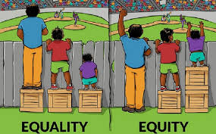
Models of Digital Governance
Hierarchy is inherent in the government departments. Equity based information flow may not be always compatible with government functioning.

Slide 5
Models of Digital Governance
Therefore, appropriate administrative reforms and some reengineering may be required before e-governance may be really implemented.
These models of governance are fundamentally different from those which are popular in developed countries due to differences in the basic conditions, and perspectives and expectations from good governance.

Slide 6
Models of Digital Governance
The six generic models of digital governance in developing countries are:
Broadcasting/Wider Dissemination Model
Critical Flow Model
Comparative Analysis Model
Mobilization and Lobbying Model
Interactive Service Model
E-Governance Maturity Model
These models exhibits several variations dependent on the local situation and the governance functions.

Slide 7
Broadcasting/Wider Dissemination Model
Principal
The model is based on dissemination of information relevant to better governance that is already in the public domain into wider public domain through the use of ICT and convergent media.
The rationale behind the model is that a more informed citizenry is able to understand better the governance mechanisms and is more empowered to make informed choices and exercise its rights and responsibilities.
Further, there is a greater likelihood that the society in which the individuals are equally informed will ensure that the agenda and forms of governance are not biased.

Slide 8
Broadcasting/Wider Dissemination Model
Principal
The wider dissemination models opens up an alternative channel for people to access information as well as validate information available in the local domain from external sources.
The widespread application of this model gradually corrects the situation of information failure and provides people with the basic government-related information to come to a common understanding and decide upon the future course of action.

Slide 9
Broadcasting/Wider Dissemination Model
Application
Putting government laws and legislation online.
Making available the names, contact addresses, e-mails, and fax numbers of local governmental officials online.
Making available key information pertaining to governmental plans, budgets, expenditures, and performances online.
Putting key court judgment/judicial statements that are of value to common citizens and creating precedence for future actions online
Notes:
4. key environment related judgments, State Vs Citizen court rulings, etc.

Slide 10
Broadcasting/Wider Dissemination Model
Evaluation
This model is the first step to more evolved forms of digital governance models.
It is also the most crucial one as it catalyses free access and flow of information to all segments of society and serves as the building block to better governance.
However, this model loses its effectiveness where free flow of information is not encouraged or it is not an objective.
Tight governmental controls and bids to censor the content being transmitted through this model
Notes:
The onus is therefore both on governmental organizations as well as civil society organizations to ensure that such models continue to proliferate.

Slide 11
Critical Flow Model
Principal
The model is based on channelling information of critical value to a targeted audience or spreading it in the wider public domain through the use of ICT and convergent media.
The model requires foresight to understand the significance of a particular information set and use it strategically.
It may also involve locating users to whom the availability of a particular information set would make a critical difference in initiating good governance.

Slide 12
Critical Flow Model
Principal
The strength of Critical Flow model is the inherent characteristics of ICT that makes the notion of distance and time redundant.
This reduces the cases of exploitative governance possible earlier due to time lag between availability of information to different users.

Slide 13
Critical Flow Model
Applications
Information on corruption of a particular government ministry or government officials to its electoral constituency or to the concerned governing body .
Research studies, enquiry and appraisals reports by the government to the affected parties.
Human rights violation and criminal charge records against government officials to NGOs and concerned citizens; and
Environment related information to local communities, for example, information on radioactivity spills, waste discharge in rivers, green ratings of a company, etc.

Slide 14
Critical Flow Model
Evaluation
Critical Flow Model is more focused in terms of its information content and its intended users.
Due to critical aspect of information, the model exposes the weakest aspects of governance and decision-making mechanisms and informs people about specific cases of state failure and bad governance to build up a case for concerted action.
At the same time, by fuelling public unrest, the model exerts pressure on the concerned government institutions and individuals to take into cognizance the interest and opinion of the masses in decision making processes.

Slide 15
Critical Flow Model
Evaluation
The importance of creating such models may lie more with the civil society organizations to emerge as an effective watch to guard to government policies and actions.
The model will not work in cases where government mechanisms do not foster public debates and critical nature information
It will also fail where the government maintains a tight control over all information which are restricted to top few levels of the government.
Inherently, the Internet is an open medium. Thus, restricted dissemination is typical i.e. only interested parties can use the critical and subject based information.

Slide 16
Comparative Analysis Model
Principal
The Comparative Analysis Model is based on exploring information available in the public or private domain and comparing it with the actual known information sets to derive strategic learning and arguments.
The model continuously integrate new knowledge, products and uses them as a benchmark to evaluate, influence or advocate changes in current governance policies and actions.

Slide 17
Comparative Analysis Model
Principal
The comparison could be made over a time scale to get a snapshot of the past and the present situation (before-after analysis) or between two different situations to understand the effectiveness of an intervention (with or without analysis).
The strength of this model lies in the boundless capacity of ICT to store information in a retrievable manner and transmit it almost instantaneously across all geographical and hierarchical barriers.

Slide 18
Comparative Analysis Model
Applications
Gauging the effectiveness of current policies and learning from government policies and actions of the past.
Establishing conditions of prior precedence, especially in the case of judicial or legal decision-making and use it to influence future decision-making. This could be useful in resolving patent-related disputes, public goods ownership rights, etc.
Enabling informed decision-making at all levels by enhancing the background knowledge and provide a rationale for future course of action.
Evaluating the performance record of a particular government official or ministry.

Slide 19
Comparative Analysis Model
Evaluations
Developing countries can effectively use this model to their advantage as ICT opens access to global and local knowledge products at a relatively low cost.
Watch-guard organizations and monitor groups could use the model to track the performance records of electoral candidates and share them in their constituency.
The model is, however, dependent on the availability of comparative information sets and the ability of the users to analyse.
However, it becomes ineffective in the absence of a strong civil society interest and short public memory.

Slide 20
Mobilization and Lobbying Model
Principal
Mobilization and Lobbying Model is one of the most frequently used digital governance models and has often come to the aid of civil society organizations in developing countries to impact international decision-making processes.
The model is based on planned, directed, strategic flow of information to build strong virtual allies to strengthen action in the real world.
It takes up the proactive approach of forming virtual communities which share similar values and concerns, promoting active sharing of information between these communities, and linking them with real-world activities.

Slide 21
Mobilization and Lobbying Model
Principal
The strength of this model is in the diversity of its virtual community, and the ideas, expertise and resources accumulated through virtual forms of networking.
The model is able to effectively overcome geographical institutional and bureaucratic barriers to shape concerted action.
It also provides a strong virtual arm to several activities such as directing campaigns against a particular individual or decision making body.

Slide 22
Mobilization and Lobbying Model
Applications
Fostering public debates on global issues, themes of upcoming conference, treaties, etc.
Formation of pressure groups to pressurize decision-makers to take their common concerns into cognizance.
Amplifying the voices of marginalized people groups such as backward classes or minorities who are traditionally marginalized from the decision making process.
Encouraging wider participation in decision-making processes.
Developing global expertise on a particular theme in the absence of localized information to aid decision-making.

Slide 23
Mobilization and Lobbying Model
Evaluations
The mobilization and Lobbying Model enhances the scope of participation of individuals and communities in policy issues and debates.
The model also creates an effective warning for government bodies and individuals to be watchful in their actions in case they turn opinion of local and global community against them.
This model could be effectively used by the Government to encourage public debates and to gauge public opinion on a particular issue as a part of good governance strategies.

Slide 24
Interactive-Service Model/Government-to-Citizen-to Government Model (G2C2G)
Principal
Interactive-Service Model in many ways is a consolidation of the earlier digital governance models and opens up avenues for direct participation of Individuals in the governance processes.
This model fully captures the potential of ICT and leverages it for greater participation, efficiency and transparency in the functioning of government as well as savings in time and costs relating to decision-making.

Slide 25
Interactive-Service Model/Government-to-Citizen-to Government Model (G2C2G)
Principal
The Interactive-Service Model makes possible various services offered by the government to be directly accessible to citizens.
It creates an interactive Government-to-Citizen-to-Government (G2C2G) channel in various functions such as election of government services, sharing of concerns and providing expertise, conducting opinion polls on public issues, and grievance redressal.

Slide 26
Interactive-Service Model/Government-to-Citizen-to Government Model (G2C2G)
Application
Establishing an interactive communication channel with policy-makers such as videoconferencing and online dialoguing.
Conducting electronic ballots for the election of government officials and other office bearers.
Conducting public debates/opinion polls on issues of wider concern before formulation of policies and legislative frameworks.

Slide 27
Interactive-Service Model/Government-to-Citizen-to Government Model (G2C2G)
Application
Filing of grievance petitions, feedback and reports by citizens with the concerned governmental body.
5. Performing governance functions online such as revenue collection, filing of
taxes, governmental procurement, payment transfers, etc.
6. Carrying out videoconferencing, and online discussion with policy makers.

Slide 28
Interactive-Service Model/Government-to-Citizen-to Government Model (G2C2G)
Evaluation
This model is more embedded in e-governance initiatives in the developed countries and has often been proposed for implementation in developing countries. Such forms of solutions transfer may not be very effective.
The model is on the higher end of technology reliance as compared to the other models. This makes it difficult to replicate in developing countries in the absence of individual and secure ICT access.
Various other issues also need to be considered carefully before such blind duplication can be attempted in the developing countries.
However, the trend is definitively in this direction and sooner or later, this model will be implemented in all the countries with due modifications for local adaptation.

Slide 29
Evolution in E-governance and Maturity Models
E-governance journey encounters several milestones that need to be identified and modelled so that efforts invested can be assessed and an appropriate course of action be taken by the organization to further its way on the path of e-governance.
The E-governance Maturity Model (EMM—version 1.0) proposes five levels of maturity, depending on the effectiveness with which the e-governance efforts have been initiated, pursued , utilized and institutionalized.
EMM 1.0 will facilitate government organizations to assess the current level of e-governance initiatives and accordingly make efforts for the future.

Slide 30
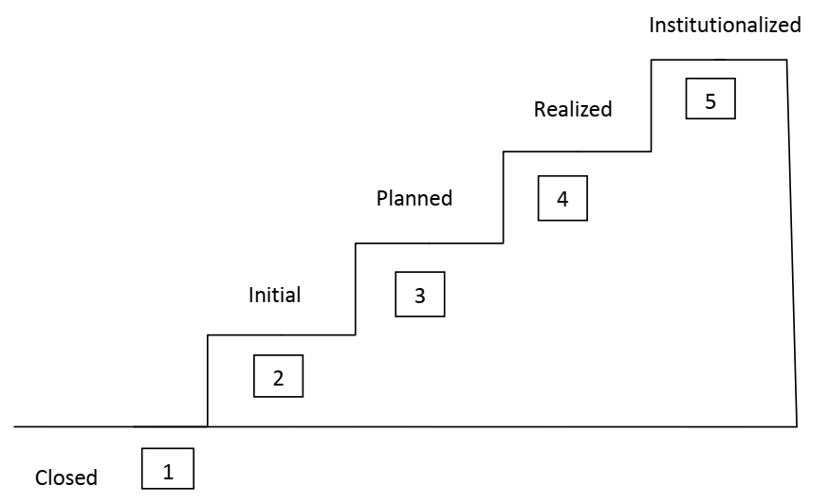
Evolution in E-governance and Maturity Models
E-governance maturity levels can be depicted as in the figure below:

Slide 31
Five Maturity Levels
The E-governance Maturity Model (EMM—version 1.0) is based on the fact that speed, openness and ubiquity are some of the major capabilities of ICTs, which can be leveraged for generating transparency, responsiveness and accountability in the system and it also empowers the common man by providing faster access to right information at the right time.
It is also based on a service-oriented approach, where public administration is seen as a professional activity and efficient delivery of services to the internal and external users.

Slide 32
Five Maturity Levels
Level 1 : Closed
This is the stage when an organizations does not use ICT as a facilitator for good governance and has no plans to do so in the near future.
This situation may arise due to lack of exposure to ICTs and associated benefits that again may depend upon a number of reasons; remoteness from the mainstream in terms of location is primary, and lack of resources and strategic thinking could be some of the other issues.
As a result, the organization is 'closed' in terms of being connected and sharing of information in the context of 'e'-governance.
Although, the organization may be efficiently functioning in this condition, all organizations may take up ICT implementations sooner according to the current trend.

Slide 33
Five Maturity Levels
Level 2 : Initial
This level corresponds to the stage when an organization has initiated the automation of its processes but on a ad-hoc basis.
No organized efforts are made to undertake the e-governance initiatives.
Also, due to lack of direction many such e-governance efforts are abandoned at a subsequent date

Slide 34
Five Maturity Levels
Level 3 : Planned
The e-governance initiative, at this level, is undertaken with a systematic approach.
The organization has a clearly defined vision, objectives and goals for e-governance.
A need assessment study is conducted to prioritize areas of implementation and gauge the extent of e-readiness.
Taking input from the need, assessment study, extensive planning has been carried out indicating policies, strategies, various activities, stakeholders, roles and responsibilities and resources required in terms of time, money and manpower to undertake the e-governance exercise.
However, the organization is yet to enter into the planned implementation of the e-governance exercise, even though all the requisite planning is completed.

Slide 35
Five Maturity Levels
Level 4 : Realized
This level corresponds to the stage when the organization actually realizes the complete e-governance plan.
Consequently, an integrated system is established where all the internal processes of the organization are computerized and there is seamless information exchange among all concerned entities.
The organization starts delivering the services to its external as well as internal customers/users in an effective manner.

Slide 36
Five Maturity Levels
Level 4 : Realized
A further classification within this level has been proposed that measures the extent of realization of the plan over a period of time.
Retrospected : At this level, the organization has retrospectively studied its business processes in view of its vision, objectives, the series-oriented approach and changes, if required, in the processes are initiated as a constant evolutionary process.
E- Ready : In this stage, e-readiness essentials are ensured by the organization.

Slide 37
Five Maturity Levels
Level 4 : Realized
Partially Open : At this stage, some of the e-governance services are operationalized resulting in a partial information exchange among the entities, both within and outside the organization.
Open : This sub-level of realized state implies complete deployment of e-governance services that ensure an integrated system that is open to information exchange. The focus here shifts from acquiring and implementing 'e' enabling factors to effectiveness with which the services are delivered. The system gains responsiveness to deal with the customer needs and is accountable for its services.

Slide 38
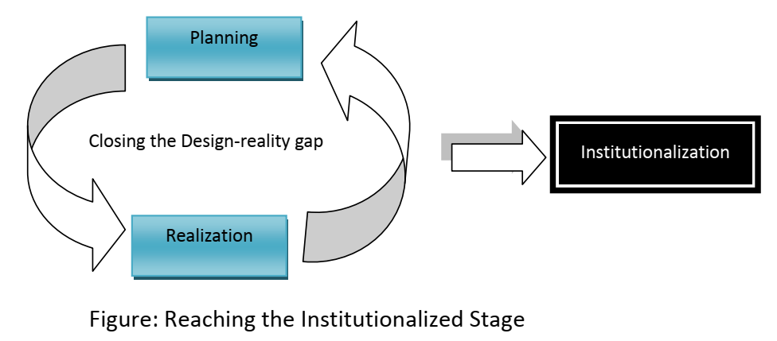
Five Maturity Levels
Level 5 : Institutionalized

Slide 39
Five Maturity Levels
Level 5 : Institutionalized
At this level, the organizations sustain the realized state over a period of time so that e-governance becomes part of its work culture.
The e-governance services are effectively utilized and accepted by the users.
Several iterations between planned and realized state lead to institutionalization, when e-governance becomes a way of life. This level needs:
Presence of strategic thinking, leadership and commitment among top level decision makers.

Slide 40
Characteristics of Maturity Levels
The characteristics exhibited by the organizations at various levels of maturity facilitate assessing the current level of e-governance attained by the organization. The following points describe the characteristics of the organizations at various levels:
Level 1 : Closed
Organizations are closed to e-governance. No plans or vision is available. They continue with fully manual and conventional operations.

Slide 41
Characteristics of Maturity Levels
Level 2 : Initial
Organization lacks strategic thinking and direction for e-governance at top level.
There are unorganized and isolated efforts of automation in some areas.
Automation efforts are a result of individual's initiatives.
The effort sustains as long as the enthusiasm of the individual, who initiated it. It remains and is often abandoned due to lack of direction.
Such organizations generally accumulate hardware without any planning and much of it goes unutilized or underutilized.

Slide 42
Characteristics of Maturity Levels
Level 3 : Planned
E-governance is a part of organization's agenda.
Strategic thinking and leadership guide the e-governance initiatives.
Clear understanding of e-governance needs as projected by the external and internal customers/users.
Extensive plan is prepared for implementing e-governance, addressing all Key Focus Areas (KFAs) and other related issues

Slide 43
Characteristics of Maturity Levels
Level 3 : Planned
All the necessary documents for e-governance planning are collected in a place. These documents include Vision and Scope, Need Assessment, Survey document, Policy guidelines, and Action Plan and Outsourcing guidelines for e-governance.

Slide 44
Characteristics of Maturity Levels
Level 4 : Realized
Retrospected
Business processes are attuned with the vision and overall e-governance objectives.
There is awareness about e-governance among all concerned stakeholders as well as the customers/users.
E-Ready
The organization has a sound infrastructure (technological, institutional, legal, and human) in place for implementing e-governance.
The customers/users are oriented and motivated to use e-governance services.

Slide 45
Characteristics of Maturity Levels
Level 4 : Realized
Partially Open
Some of the e-governance services are deployed, leading to partial information exchange among the entities.
Partially open organizations sometimes focus only on their internal or backend processes, allowing an information exchange within the confines of the organization thus remaining insulated from its external entities. In such cases, Government-to-Employee (G2E) interface is visible, whereas Government-to-Citizen (G2C), Government-to-Government (G2G) and Government-to-Business (G2B) interfaces are not yet established.

Slide 46
Characteristics of Maturity Levels
Level 4 : Realized
Partially Open
Another case of partial deployment of e-governance services result in the limelight G2C interface with no emphasis on building G2E, G2B, or G2G interfaces. In an enthusiasm to quickly open up its front-end, the organization negligibly focuses on computerization of the supporting backend processes, thus creating hollowness behind the face of static web sites.
A hybrid of the above two cases is characterized by building interfaces with external entities and simultaneously focusing on computerizing the corresponding backend processes, thus opening a balanced information exchange among the internal as well as the external customers of the organization.

Slide 47
Characteristics of Maturity Levels
Level 4 : Realized
Open
The organization has an integrated system, reflective of smooth information exchange within and outside the organization, i.e. Government-to-Employee (G2E), Government-to-Citizen (G2C), Government-to-Government (G2G) and Government-to-Business (G2B) interfaces are well established over a sound foundation of e-governance building blocks (the e-readiness essentials).
Organization focuses on satisfying the users of e-governance services.
The internal and external customers/users of the organization start utilizing the e-governance services and become dependent on them.

Slide 48
Characteristics of Maturity Levels
Level 5 : Institutionalized
The e-governance system of the organization is driven by a well established Knowledge Management System that generates an ability in the organization to evolve with time in view of new requirements.
E-governance becomes an effortless exercise for the organization and it becomes a way of life for the stakeholders and customers/users.
The organization at this level is completely paperless.

Slide 49
Key Focus Areas
Key Focus Areas (KFAs) indicate the areas that need to be focused by an organization and are a set of related activities when performed collectively to achieve a particular level of maturity.
KFAs are defined from level 3 (Planned) onwards, as this is the stage from where e-governance effort is systematically attempted.

Slide 50
Key Focus Areas
Planned
Define a calculable vision for the e-governance exercise.
Conduct a Needs Assessment Survey in view of objectives covering the following areas:
Survey of requirements both within and outside the organization
Analyse the requirements to identify priority areas for initiating e-governance exercise.
Assess the extent of e-readiness to identify areas and requirements to achieve the desired level of e-readiness.

Slide 51
Key Focus Areas
Planned
Prepare an extensive plan on e-governance that includes the following areas:
Define objectives and goals for the e-governance exercise.
Design policies and strategies for implementing e-governance.
Decompose the e-governance exercise into various activities.
Project the resource requirements in terms of time, money and manpower.
Identify stakeholders and assign roles and responsibilities.
Define implementation methodology.
Define measures for attaining required level of e-readiness.

Slide 52
Key Focus Areas
Planned
Prepare an extensive plan on e-governance that includes the following areas:
Define measures for creating awareness and change in mindset among the external and internal customers/users of the organizations for effective implementation of e-governance. Identify risk factors and propose risk mitigation plan.
Define the expected impact and propose an impact assignment methodology.
Identify external sources of funds, if required.

Slide 53
Key Focus Areas
Planned
Prepare an extensive plan on e-governance that includes the following areas:
Define mechanisms (Research and Development, Knowledge Management Initiatives) for developing innovative ways of delivering services within the organization and outside it.
Define the time for which the plan is valid.
Prepare all the necessary documentation including Vision and Scope document for e-governance, Need Assessment, Survey document, Policy guidelines, Action Plan and Outsourcing guidelines.

Slide 54
Key Focus Areas
Realized
Arrange resource required to implement the e-governance initiative.
Develop a high level awareness and commitment among decision-makers, stakeholders and users to initiate and carry forward the e-governance objectives.
Select vendors for outsourced activities and formalize terms and conditions with all the stakeholders, clearly assigning roles, responsibilities and ownership.
Set up management committees with appropriate representation of all stakeholders for executing and monitoring the e-governance exercise.
Conduct a detailed study and review of the existing business processes in view of e-governance objectives.
Initiate the change in business processes wherever required, and bring in suitable legislation to make it effective.

Slide 55
Key Focus Areas
Realized
Acquire and/or design, develop, test and deploy e-governance services with the following issues in mind:
Address information needs of common man in local language with easy to use interface.
Address the issues related to standardization of content and data to facilitate seamless flow of information among concerned entities.
Ensure interoperability in terms of interconnectivity, data integration and information access.
Use open standards.
Ensure easy accessibility to information.
Provide efficient data communication.

Slide 56
Key Focus Areas
Realized
Build scalable architecture.
Ensure wide market support (supply from multiple vendors).
Ensure wide product support (interconnection between products from diverse vendors).
Ensure cost effectiveness.
Conduct extensive training for customers/users and administrators for effective operationalization and utilization of e-governance services.
Collect, compile, validate, and update data/content.
Maintenance activities.
Conduct an Impact Analysis to assess the effectiveness of service delivery.
Initiate activities (surveys, research and development, knowledge management initiatives) to devise more innovative ways of developing and delivering e-governance services.

Slide 57
Key Focus Areas
Institutionalized
Address the design-reality gaps, if any, by iterating between planning and realization phases.
Evolve a mechanism (knowledge management system, research and development initiatives and surveys) to make a e-governance an effortless so that the entire system develops an ability to evolve and scale up with time and new requirements.

Slide 58
Towards Good Governance through E-Governance
The digital governance models bring about a transformation in the existing forms of governance as they change the nature of citizen-governance relationship and bring new agenda and mechanisms to influence the governance processes.
They foster democratic control over the governments' economic, social and welfare policies by citizens and civil society organizations—a key process requirement for good and responsive governance.

Slide 59
Towards Good Governance through E-Governance
The changes brought about in the citizen-governance relationship through digital governance are fourfold:
They open up avenues for flow of information both vertically and laterally to encompass a wider foundation of the civil society. The right to voice and expression gets gradually embedded among citizens through digital means.
Information becomes difficult to be capitalized by a few for political gains at the expense of ignorance of citizens. The power equations shift from being concentrated at select nodes to its even distributions among citizens, opposition parties and watchguard groups.

Slide 60
Towards Good Governance through E-Governance
The changes brought about in the citizen-governance relationship through digital governance are fourfold:
3. There is a greater scope influence policy-makers and members of civil society through collective opinion, direct participation, participation in public debates and use of advocacy tools.
4. Policy-makers become more aware of the voices of people and can effectively involve them in policy-making mechanisms. They realize that their actions are under the scrutiny of many more watchguard organizations and there are greater avenues available with people to obtain any information.

Slide 61
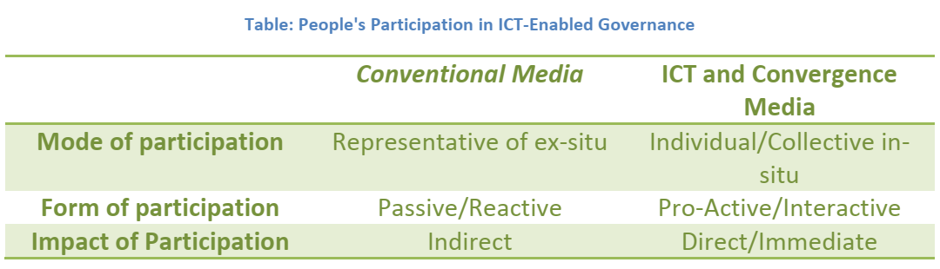
Towards Good Governance through E-Governance
The following table summarizes the nature of people's participation in e-governance.

Slide 62
Towards Good Governance through E-Governance
Since ICT-enabled governance models can directly connect individuals with officials in the government and decision-makers, the impact is immediate, and puts greater assess and control over governance mechanism in the hands of individuals.
This process makes the government more responsible and accountable to its citizens.
Digital governance models bring with them the potential to bring in far-reaching changes in governance structures in developing countries.

Slide 63
Towards Good Governance through E-Governance
Creativity lies in the use of information and blending it with the potential offered by ICT to create customized low-cost digital governance models.
Solutions may often emerge by analysis of reasons behind governance failures by the people themselves and then imaginatively using digital governance models to focus on the weakest spot to bring gradual improvements in governance.
Small businesses are significant landmarks in the path of transformation to good governance.

Slide 64
Thank you

